Slide 1
Build smarter agents with Redis, .NET and Agent Framework
.NET 10 Conference

Slide 2

Matt Soucoup
Catherine Wang
PRINCIPAL CLOUD ADVOCATE
Product Manager, Azure Redis

Slide 3

0
What is Azure Redis
Agenda
1
.NET for Redis ecosystem
2
Use Redis to improve .NET MCP server efficiency
3
Demo: hybrid cache with weather MCP server
4
Upload data into Redis
5
Demo: Upload data to Redis with Azure Function
6
Use Redis in a .NET Aspire Exact QnA Agent
7
Demo: Aspire Agent with Redis
Notes:
Catherine
Matt will make comment about AI functionality – this is how flexible across app types

Slide 4
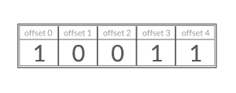
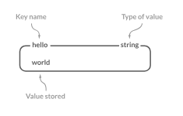
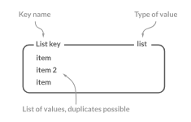
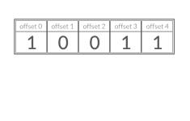
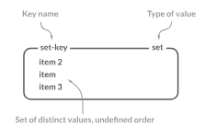
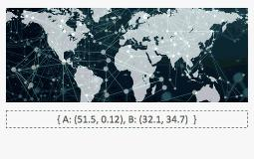
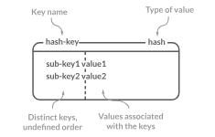
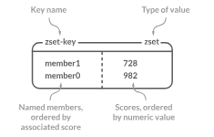
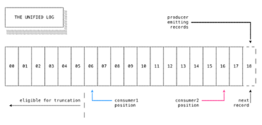

Azure Redis service overview
REmote DIstributed Server
In-memory key-value pair
Azure Managed Redis
https://aka.ms/azure-managed-redis
Strings
Lists
Bitfields
Scalability
Broad range of SKUs from 0.5 to 2000G
HyperLogLog
High-availability
Up to 99.999% SLA with active geo replication
Geospatial indexes
Sets
Hashes
Security
Secured with Microsoft Entra ID and Azure Networking
Scheduled maintenance
Sorted sets
Streams
Configure for receiving patching during non-business hours
Bitmaps
More features
Persistence, active geo replication, Azure service integrations, etc.
Source: https://redis.io/technology/data-structures/
Notes:
Use for data caching, session storage, content caching, distributed transactions, Modern AI w/ different content types.
Catherine will ask questions
Azure Managed Redis => 1st party service so it brings in all the capabilities listed

Slide 5

.NET for Redis
NEW: Redis Enterprise support in Aspire.Hosting.Azure.Redis with Aspire 9.5 +
Ecosystem
// Add Azure Redis Enterprise - will be provisioned in Azure
var redis = builder.AddAzureRedisEnterprise("redis");
Microsoft.Extensions.Caching.Hybrid
Redis.OM
.NET Output Cache
NRedisStack
Microsoft.Azure.StackExchange.Redis
https://github.com/redis/mcp-redis
Microsoft Agent Framework for .NET
https://github.com/Azure/azure-mcp
Notes:
Enterprise support w/ Aspire support => enterprise means it will be provisioned (give you redis vectorsearch and other modules which feed the AI scenarios)
Provisions much faster.
MCP server samples => handoff to Catherine

Slide 6
Use Redis to improve .NET MCP server efficiency
Caching
Semantic Routing
Vector store
i.e. Hybrid cache
Filter the tools using semantic search
Vector similarity search in backend store
Use libraries like HybridCache and others for reusing responses from frequently accessed data, session, output caching, etc.
Use semantic query search for top tool selections
Use Vector Similarity Search in the intelligent Redis datastore
Notes:
Introduction to the demo – w/ 3 scenarios for MCP server
EntraID is supported everytwhere
Classic caching concepts still apply
Semantic Routing is done by MCP client => apply filters for tooling
Vector store = > RAG & etc

Slide 7
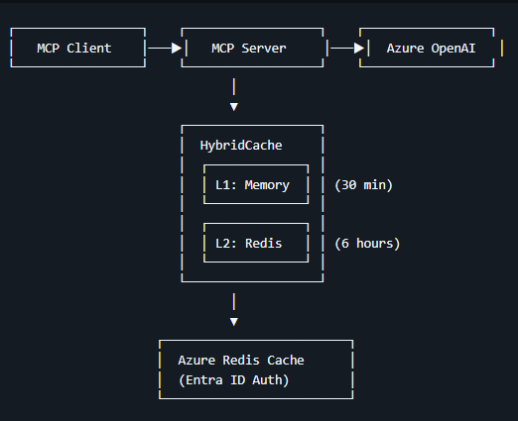
Figure 1: workflow diagram for the weather MCP server.
Demo: hybrid cache with weather MCP server
https://aka.ms/redis/demo/weather-mcp-redis

Slide 8
Upload data into Redis
Azure Function
Redis Data Integration tool
Redis MCP servers
i.e., blob trigger
https://redis.io/data-integration/
https://github.com/redis/mcp-redis
Upload a .json or .csv file to trigger an Azure Function to process the data
Redis Data Integration (RDI) synchronizes data from your database into Redis in near-real time, so you can say goodbye to cache misses and stale data.
The Redis MCP Server is a natural language interface designed for agentic applications to efficiently manage and search data in Redis.
Notes:
Catherine will take this slide
Different ways to get data into Redis => 3rd party tooling. And then can build your own w/ Aazure Functions
Azure functions => we control to do it
Integration tool => hydrates from persistent data store

Slide 9
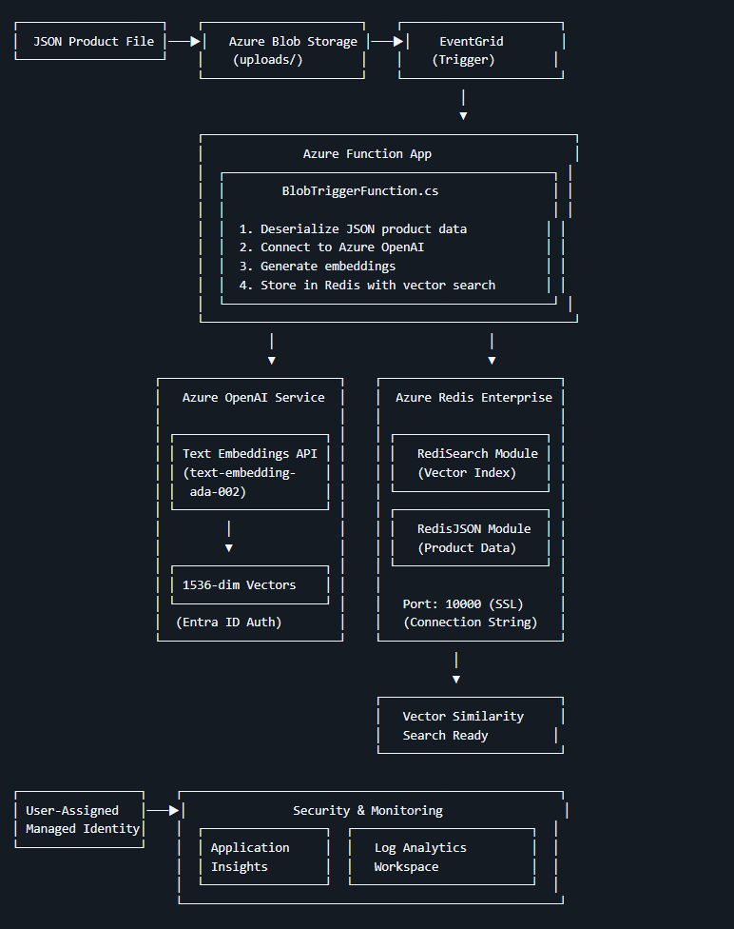
Figure 1: Architecture diagram for using Azure Function to create data in Redis
Demo: Upload data to Redis with Azure Function
https://aka.ms/redis/demo/Function-UploadData-Redis

Slide 10
Use Redis in a Aspire Agent
User session
Chat history
Knowledge
Semantic cache
Distributed cache
Output cache
Cache the user info like user name in the agent
Store the conversation thread and chat history for context
Vector store for RAG on your enterprise organization’s information
Return consistent answers from semantically similar questions
Traditional cache-aside pattern for accessing frequently accessed data
Save server resource by caching rendered html
Notes:
Matt
Semantic Cache => saves on calls to LLMs w/ consistency (cache the LLM outputs)

Slide 11
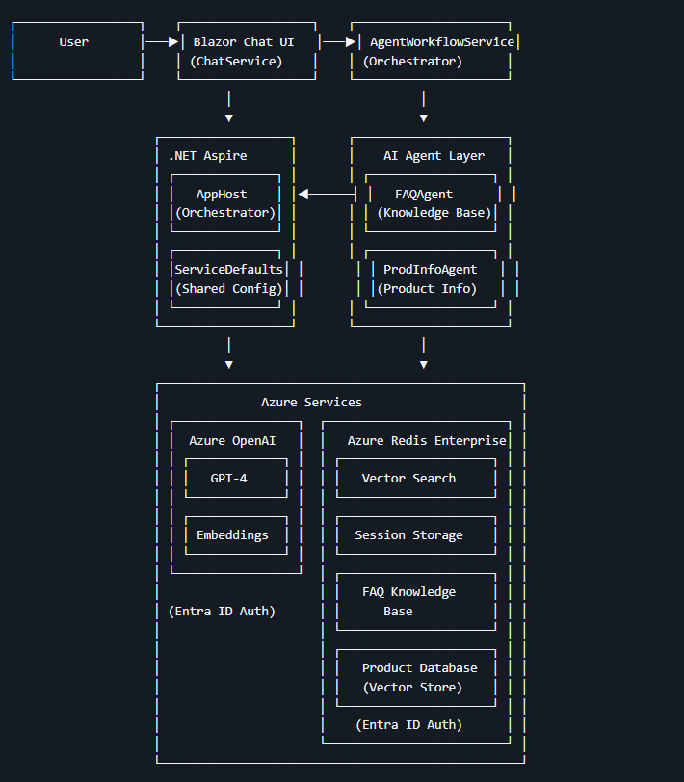
Figure 1: Architecture diagram for QnA Aspire Agent
Demo: Aspire Agent with Redis
Demo: Aspire Agent with Redis
https://aka.ms/redis/demo/Redis-AgentFramework-Aspire

Slide 12

Thank you
https://aka.ms/redis/demo/Redis-AgentFramework-Aspire
https://aka.ms/redis/demo/Function-UploadData-Redis
https://aka.ms/redis/demo/weather-mcp-redis
Notes:
Matt asks Catherine for wrap up.

Slide 13
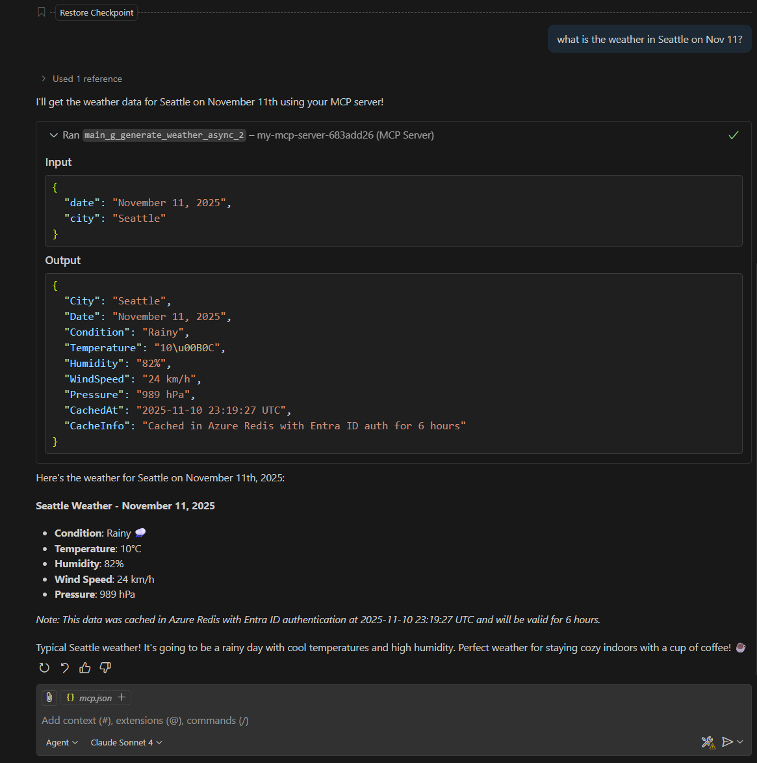

Slide 14
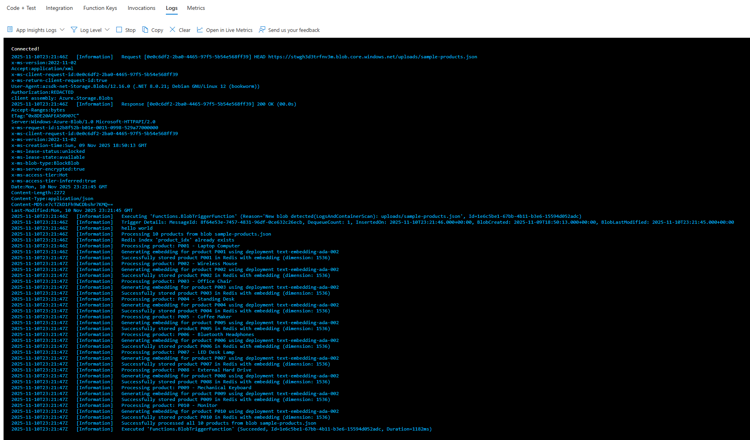

Slide 15
